Slide 1
- FAZIL BISHARA
PTMC

Slide 2
Until the first publication by Inoue and coworkers describing percutaneous mitral commissurotomy (PMC) in 1984, surgery was the only treatment for patients with mitral stenosis.

Slide 3
PMC acts in the same way as surgical commissurotomy, by opening the fused commissures .
PMC is of little or no help in cases of restricted valvular mobility caused by valve fibrosis or severe subvalvular disease.

Slide 4
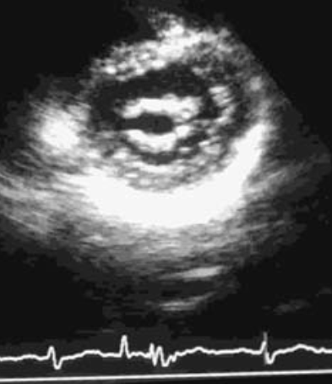
Mechanism of BMV - Splitting of the fused commisures

Slide 5
patient sellection
The selection of patients for PTMC procedure is a complex decision involving the consideration of-
the clinical profile
valve morphology

Slide 6
Evaluation of the patient must take into account –
the degree of functional disability,
the presence of contraindications to trans-septal catheterization,
the risks involved in surgery.

Slide 7
It is critical to ensure that there are no anatomic contraindications to the technique.
Left atrial thrombosis
Mitral regurgitation greater than ¼
Massive or bicommissural calcification
Severe aortic valve disease, or severe tricuspid stenosis plus regurgitation, associated with mitral stenosis
Severe concomitant coronary artery disease requiring bypass surgery

Slide 8
Most investigators use the Wilkins score , in which a total score under 8 is considered to represent favorable anatomy for PMC

Slide 11
THE BEST PATIENTS FOR PMV
Optimal candidates for PMV are those patients meeting the following characteristics:
age 45 years old or younger
normal sinus rhythm
echocardiographic score less than or equal to 8
no history of previous surgical commissurotomy
pre-PMV MR less than or equal to 1+ Sellers grade.

Slide 12
There are two approaches—
trans-arterial
&
trans-venous
main techniques—
double-balloon technique
Inoue technique
metallic valvulotome
retrograde technique

Slide 13
Selection of Appropriate Balloon Size
A simple equation to obtain the reference size (height [cm]/10+10) has been proposed.
The relationship of one’s height to the diameter of the mitral valve orifice is not necessarily linear.
Annular calcification will affect the size of the mitral valve orifice regardless of the patient’s physical constitution.

Slide 14
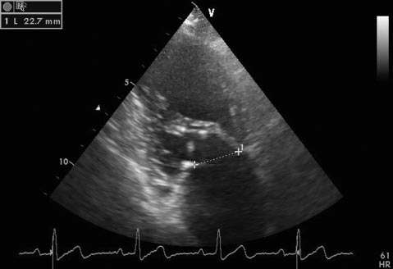
Select the balloon size by directly measuring the mitral annular diameter using 2-D echocardiography. The minimal mitral annular diameter should be adopted to avoid the risk of tearing the leaflets.
The mitral annular diameter
can be measured on the apical
4- or 2-chamber view during
mid- to end-systole.

Slide 15
GENERAL CONSIDERATIONS
PMV is usually performed on fasting patients
obtain a TEE to confirm the pre-PMV Wilkins valve score, quantify the baseline degree of MR, rule out the presence of intracardiac thrombus.
intraprocedural TTE to assess the baseline valve characteristics and the degree of MR after each balloon inflation.
Antibiotic prophylaxis is given before obtaining access

Slide 16
TRANS-VENOUS OR ANTEGRADE APPROACH
more widely used approach and is usually performed through the femoral vein.
Trans-septal catheterization is the first and one of the most crucial steps of the procedure.

Slide 17
Trans-septal catheterization
Trans-septal catheterization, originally developed by Cope and by Ross in 1959.
The conditions necessary for safe and successful trans-septal catheterization are
(1) knowledge of the anatomy, which may be modified in patients with mitral stenosis, in whom normal geometry has been lost because both atria are enlarged and the convexity of the septum is exaggerated
(2) knowledge of contraindications
(3) experience of the operators

Slide 18
Echocardiography during trans-septal catheterization has the potential to enhance its safety, especially in the early part of the operator’s experience.
Intracardiac echocardiography (ICE) is the current imaging tool of choice to guide trans-septal puncture.
benefits- may be used without additional operators or general anesthesia
drawback- price of the device

Slide 19
TEE or ICE can be used not only as guidance for the Brockenbrough procedure but also as a monitor to early detect serious complications .
Using angiographic landmarks alone is commonly used by seasoned operators.

Slide 20
Imaging views
Initial placement of pigtail, guidewires and transseptal systems- AP projection
To estimate ant/post placement of catheter in the atrial septum- RAO angulation
Trans-septal puncture is performed in the AP projection to see needle entry in atrium.

Slide 21
Steps of trans-septal catheterization
A pigtail catheter is placed in the aortic sinus of valsalva just above the valve for anatomic reference and measurement of aortic pressure.
A J-tipped 0.032-inch guide wire is inserted via the right femoral vein into the superior vena cava.
The trans-septal catheter and sheath is advanced over the guide wire into the vena cava and the guide wire is then withdrawn.

Slide 22
Brockenbrough trans-septal needle is now advanced through the catheter, positioned in the SVC with the metal arrow indicator pointing to the 12 o clock position with its tip about 2-3 mm proximal to the catheter tip.
The catheter-needle assembly now held fixed together is withdrawn caudally from the SVC into the RA with a clockwise rotation of the needle arrow indicator pointing at 4 o clock position

Slide 23
three sequential landmark “bumps” are traversed on withdrawal-
as it enters the right atrium/superior vena cava junction,
as it moves over the ascending aorta where the tactile sensation of aortic pulsations aids in localization
as it passes over the limbus to intrude into the fossa ovalis.
Approximately 15-20% of patients have a PFO which allows unobstructed passage of the catheter assembly into the LA without needle puncture

Slide 24
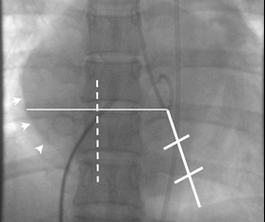
The positioning technique described by croft

Slide 25
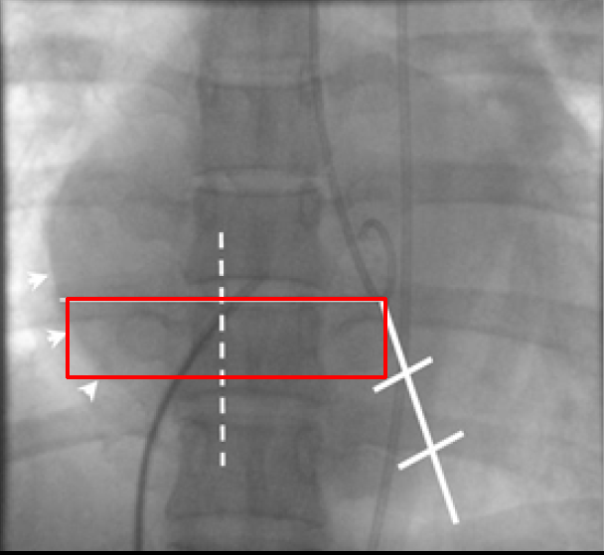

Slide 26
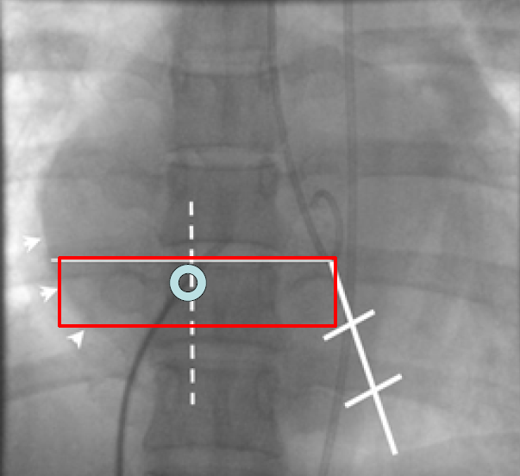

Slide 27
When the operator is satisfied with the intended puncture site, the catheter-needle is pressed firmly against the septum.
Usually cardiac pulsations (so-called septal bounce) are felt by the right hand holding the catheter needle.
While keeping the catheter firmly against the septum to prevent it from slipping away from the puncture site, the operator releases the stopper-finger and advances the needle forward.

Slide 28
The needle is aspirated and contrast medium is injected to confirm its entry into the left atrium.
Entry of the needle in the left atrium is confirmed, first by contrast medium injection followed by pressure recording and blood oximetry
If no blood is aspirated, the needle either has dissected the high septum or is caught in the thickened septum.
Staining of the septum with injection of a small amount of contrast medium easily distinguishes the two

Slide 29
Two major problems inherent in atrial septal puncture for PTMC are –
cardiac perforation
&
puncture of an inappropriate atrial septal site.
The former may lead to serious complication of cardiac tamponade and the latter to possible difficulty in maneuvering the Inoue balloon
catheter across the mitral orifice

Slide 30
INOUE TECHNIQUE
The Inoue technique was the first to be described.
Inoue balloon, composed of nylon and rubber micromesh, is self-positioning and pressure extensible.
It is large (24 to 30 mm in diameter) and has a low profile (4.5 mm).

Slide 31
The balloon has three distinct parts, each with a specific elasticity, enabling them to be inflated sequentially.
This sequence allows fast, stable positioning across the valve. There are four sizes of the Inoue balloon (24 mm, 26 mm, 28 mm, and 30 mm); each is pressure dependent

Slide 33
After LA access is obtained, the IA septum is dilated and the inoue balloon is tracked over the special guidewire into the LA.
Balloon size is chosen in accordance with the patient’s height.
26 mm in very small patients or infants
28 mm in patients shorter than 1.60 m
30 mm in patients taller than 1.60 m

Slide 34
SEQUENTIAL BALLOON INFLATION
First, the tip of the balloon is inflated with 1 or 2 mL of a diluted contrast medium which is now floated across the mitral valve, steered with a stylet.
Second, the distal part is further inflated, and the balloon is pulled back into the mitral orifice.
Inflation then occurs at the level of the proximal part and finally in the central portion, with the disappearance of the central waist at full inflation

Slide 35
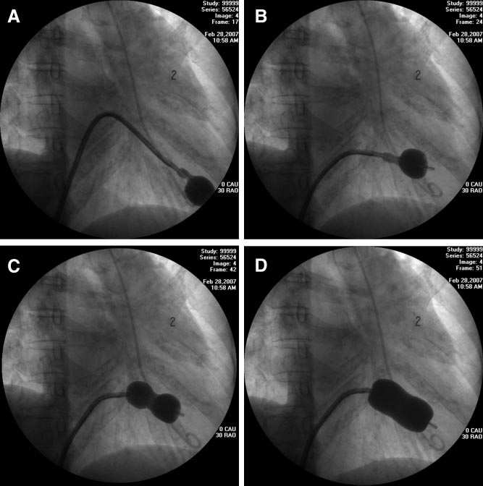

Slide 36
The first inflation is performed 4 mm below the maximal balloon size, and the balloon size is increased in steps of 1 mm each.
The balloon is then deflated and withdrawn into the left atrium. The pressure gradient across the mitral valve is measured after each balloon dilatation, and echocardiography may be used to assess the mitral valve area, leaflet mobility, and the degree of mitral regurgitation
If mitral regurgitation has not increased by more than ¼ and the valve area is less than 1 cm2/m2 of body surface area, the balloon is re-advanced across the valve, and PMC is repeated with a balloon diameter increased by 1 mm.

Slide 37
DOUBLE-BALLOON TECHNIQUE
Two 0.0038-inch (260-cm) exchange wires are placed across the mitral valve into the apex of the left ventricle or less frequently into the ascending aorta.
Two balloon-dilating catheters are chosen according to the patient’s body surface area.

Slide 39
The balloon valvotomy catheters are positioned across the mitral valve parallel to the longitudinal axis of the left ventricle.
The balloon valvotomy catheters are then inflated by hand until the indentation produced by the stenotic mitral valve is no longer seen.
Generally one, but occasionally two or three, inflations are performed. After complete deflation, the balloons are removed sequentially.

Slide 41
Monorail modification of DB technique
An adaptation of the double-balloon technique uses a monorail approach to deliver two balloons across the mitral valve over a single guidewire.
The first balloon with a short monorail segment is passed over the wire across the mitral valve, followed by a second conventional balloon that is then passed over the wire until it is parallel with the first balloon.
There are no substantial differences in the mechanism of delivery of force by two balloons using this approach compared with conventional double-wire, double-balloon technique

Slide 42
Inoue versus double balloon
Although the post-PMV MVA was larger with the double-balloon technique, the success rate, incidence of 3+ or greater MR, in-hospital complications, and long-term and event-free survival rates were similar with both techniques.
The Inoue technique eases the procedure and has equivalent efficacy and lower risk, compared to DB technique.

Slide 43
Learning curve of the Inoue technique of percutaneous mitral balloon valvuloplasty☆
Both the Inoue and the double-balloon techniques are equally effective techniques of PMBV because they resulted in similar immediate success, in-hospital adverse events, and long-term and event-free survival.
SANCHEZ PL et al
sep 2001 American journal of Cardiology

Slide 44
Optimization of Percutaneous Balloon Mitral Valvuloplasty: immediate and 10 years long term results of a modified multi-track Double Balloon Technique
Background:Single balloon direct the major force towards the leaflet while the DB technique directs the force towards the commisures.
Objectives: To test the hypothesis that stepwise dilation of mitral valve using single followed by DB ( bonhoeffer multitrack system) inflations would gradually apply bidirectional forces and hence yield better outcome.

Slide 46
METALLIC COMMISSUROTOME
During the late 1990s, Cribier and colleagues introduced the metallic commissurotome, using device similar to the Tubb dilator used during closed commissurotomy.
The technique has efficacy similar to that of balloon commissurotomy, but the risk of hemopericardium seems higher owing to the presence of a stiff guidewire in the left ventricle.

Slide 47
The device consists of a detachable metallic cylinder with two articulated bars screwed onto the distal end of a disposable catheter, on which the proximal end is connected to activating pliers. Squeezing the pliers opens the bars up to a maximum of 40 mm.
This technique is more demanding on the operator compared with the Inoue technique.
The potential advantage is that the dilator is reusable, which reduces the cost of the procedure.

Slide 49
Desired endpoint of the procedure
mitral valve area of more than 1 cm2/m2 of the body surface area
complete opening of at least one commissure
(3) appearance or increment of regurgitation greater than ¼.

Slide 51
IMMEDIATE RESULTS
The improvement in valve function results in an immediate decrease in left atrial pressure and a slight increase in cardiac index.
A gradual decrease in pulmonary arterial pressure and pulmonary vascular resistance is seen.
High pulmonary vascular resistance continues to decrease in the absence of re-stenosis.
Improvement in the pump function of the left atrium and the LAA and decrease in left atrial stiffness also occur.

Slide 52
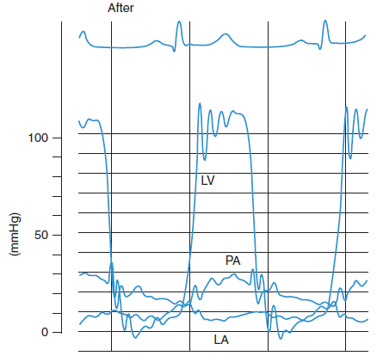

Slide 54
Complications
Procedural mortality has ranged from 0% to 3% in most series. The main causes of death are left ventricular perforation and poor general condition of the patient.
The incidence of hemopericardium has varied from 0.5% to 12%. Pericardial hemorrhage may be related to trans-septal catheterization or to apex perforation by guidewires or the balloon itself when exaggerated movement occurs with the over-the-wire techniques. however, this complication is virtually eliminated with the Inoue balloon technique.

Slide 55
If hypotension occurs during PMC, hemopericardium must be suspected.
ECHO confirms diagnosis and immediate pericardio-centesis is to be performed before secondary transfer for cardiac surgery.
Embolism is encountered in 0.5% to 5% of cases.

Slide 56
Severe mitral regurgitation is rare, its frequency ranging from 2% to 19%.
Causes of MR post BMV-
non-commissural tearing of the posterior or anterior leaflet
excessive commissural splitting
rupture of a papillary muscle

Slide 57
severe mitral regurgitation occur in patients with unfavorable anatomy- extensive subvalvular disease and valve calcification.
Severe mitral regurgitation may be well tolerated, but more often, it is not, and surgery must be scheduled.

Slide 58
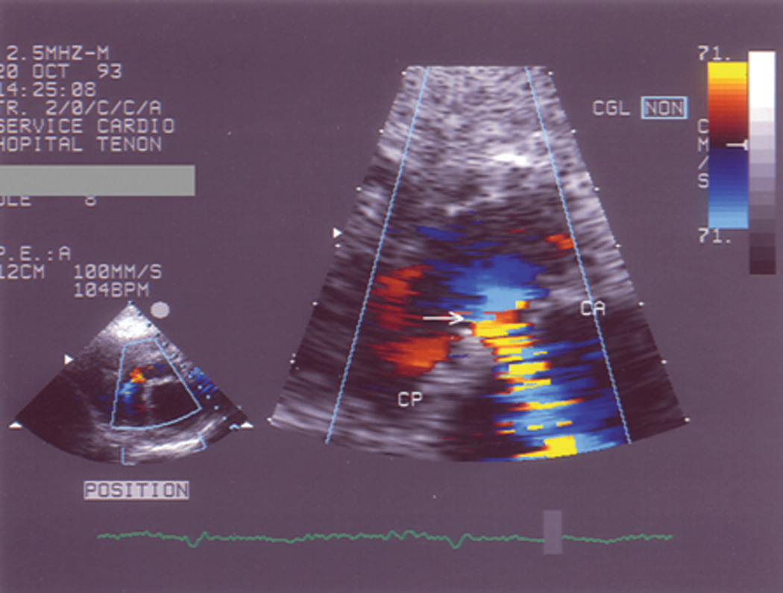

Slide 59
The frequency of ASD after PMC varies from 10% to 90%, according to the technique used for its detection. These shunts are usually small and restrictive, with high-velocity flow.
Older age
fluoroscopic evidence of mitral valve calcification
higher echocardiographic score
pre-PMV lower cardiac output
higher pre-PMV NYHA functional class
are the factors that predispose patients to develop left-to-right shunt post-PMV

Slide 61
definition of good immediate results
The two definitions frequently employed are-
(1) a final valve area larger than 1.5 cm2 and an increase of at least 25% in the valve area
(2) a final valve area larger than 1.5 cm2 without mitral regurgitation greater than 2/4.

Slide 62
LONG-TERM RESULTS
If PMC is initially successful, survival rates are excellent, the need for secondary surgery is infrequent, and functional improvement occurs in most cases.
Re-stenosis after PMC has generally been defined as a loss of more than 50% of the initial gain, with a valve area less than 1.5 cm2.
the incidence of re-stenosis is usually low, between 2% and 40%, at time intervals ranging from 3 to 10 years

Slide 63
Age, mitral valve area after PMC, and anatomy -are considered to be predictors of re-stenosis.
The ability to perform repeat valvuloplasty in cases of recurrent mitral stenosis is one of the potentials of PTMC.
Revalvuloplasty- reports positive immediate and mid-term outcomes in patients with favorable characteristics.

Slide 65
Prospective, randomized trial comparing the results of the 3 procedures in 90 patients (30 patients in each group) with severe pliable MS.
The immediate and long-term results of PMV are comparable to those of open mitral commissurotomy and superior to those of closed commissurotomy.

Slide 66
Conclusions—In contrast to surgical CMC, BMC and OMC produce excellent and comparable early hemodynamic improvement and are associated with a lower rate of residual stenosis and restenosis and need for reintervention.
However, the good results, lower cost, and elimination of drawbacks of thoracotomy and cardiopulmonary bypass indicate that BMC should be the treatment of choice for patients with tight pliable rheumatic MS.

Slide 67
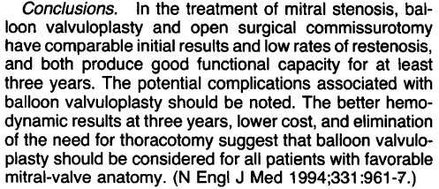
60 patients with severe MS and favourable valvular anatomy were enrolled in this prospective randomized trial comparing the two procedures

Slide 68
A prospective, randomized trial comparing percutaneous balloon commissurotomy with surgical closed commissurotomy in 40 patients with severe rheumatic MS.
Conclusions:
PTMC and surgical closed commissurotomy result in comparable hemodynamic improvement that is sustained through 8 months of follow-up.

Slide 69
PBMV for Special Patient Populations

Slide 70
Postsurgical or Balloon Commissurotomy
PBMV can safely be performed for most patients in these patients aswell.
Turgeman et al reported that patients with mitral restenosis caused by symmetrical commissural refusion obtain better results from repeat procedures compared with patients with restenosis in whom the pathological mechanism of restenosis is mainly subvalvular and commissures are not bilaterally fused but rather unilaterally or bilaterally split

Slide 71
Two major mechanisms responsible for valvular restenosis:
commissural refusion
&
progression of subvalvular thickening/ degeneration.
Outcomes were found safe and favourable for repeat PBMV, however, Ten-year event-free survival rates were slightly higher for patients who underwent initial PBMV for de novo MS.

Slide 72
Pregnant Patients
Increase in the intravascular volume by 30% to 50% in pregnancy may pose serious hemodynamic consequences by increasing the transmitral gradient and left atrial pressure, leading to acute pulmonary flash edema.
Maternal mortality-
NYHA class 1 and 2- 0.4%
NYHA class 3 and 4- 6.8%

Slide 73
PBMV is indeed effective for most of these patients and is safer than the surgical alternatives except that they should be performed by experienced operators with abdominal and pelvic shielding and with minimum radiation exposure and preferably in the 2nd trimester.

Slide 74
BMV/PTMC SUMMARY
Usually a safe procedure
Complication rates low – mostly Valve tear and MR – 3%
Gratifying results in majority of patients.
The procedure of choice in pliable mitral stenosis

